Slide 1

Customer Shopping Behavior Analytics
Retail Sales Performance Analysis Using Bigquery and Tableau
Presented by: Donald Benoit
Tools Used: BigQuery SQL, Tableau Public, Excel/CSV
541,909 Transactions Analyzed ~ $10.64M Revenue Evaluated ~ 4,338 Customers Studied

Slide 2
~ Objective ~
Analyze retail transaction data to identify:
Business Questions:
Revenue Trends
Customer purchasing behavior
Product performance
Revenue concentration
Business growth opportunities
What drives revenue?
Who are the most valuable customers?
Which products perform the best?
What actions can management take to increase sales?

Slide 3
Dataset Overview
Dataset Information
Dataset Summary
Source: Online Retail Dataset (UCI Repository via Kaggle) Description: Transactional sales data from a UK-based online retailer. Analysis Period: December 2010 – December 2011 Tools Used: • BigQuery SQL • Tableau Public • Microsoft PowerPoint
Metric | Value
Transactions | 541,909
Clean Records | 524,878
Customers | 4,338
Orders | 19,960
Revenue | $10.64M
Raw Data
Data Cleaning
SQL Analysis
Tableau Dashboards
Key insight: Over 541,000 transactions analyzed…

Slide 4
Data Cleaning Process
Issues Identified
Issue | Count
Missing Customer ID | 135,080
Missing Description | 1,454
Cancelled Orders | 9,288
Negative Quantity Rows | 10,624
Duplicate Rows | 5,258
Actions Taken:
Removed duplicate records
Removed cancellations
Removed negative quantities
Removed missing descriptions
Retained missing CustomerID for revenue analysis
Result:
541,909 → 524,878 clean records

Slide 5
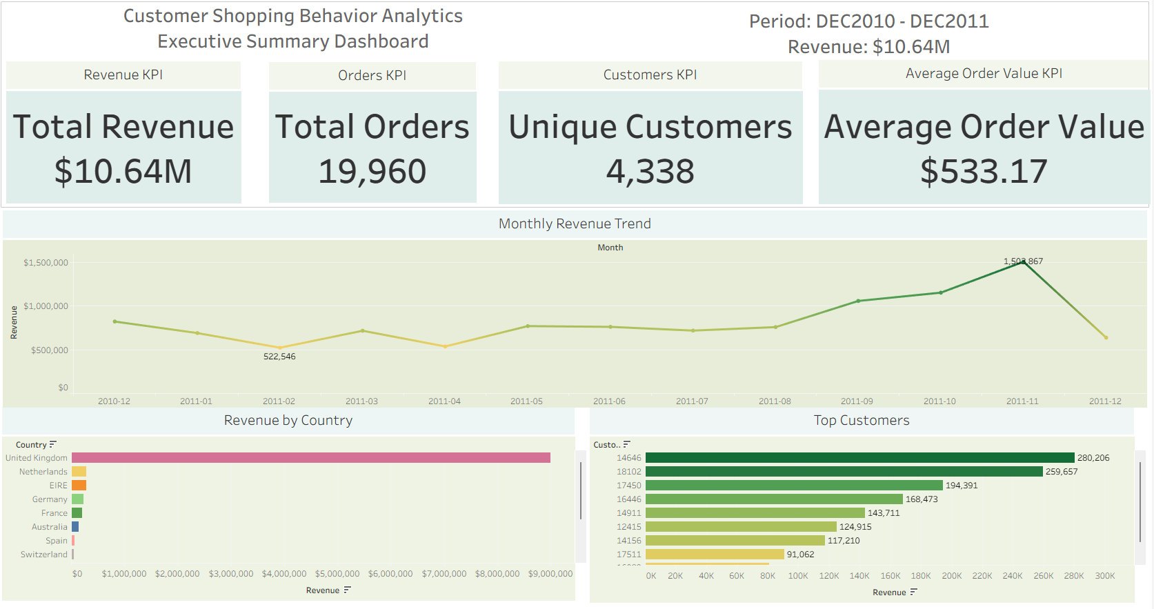

Slide 6
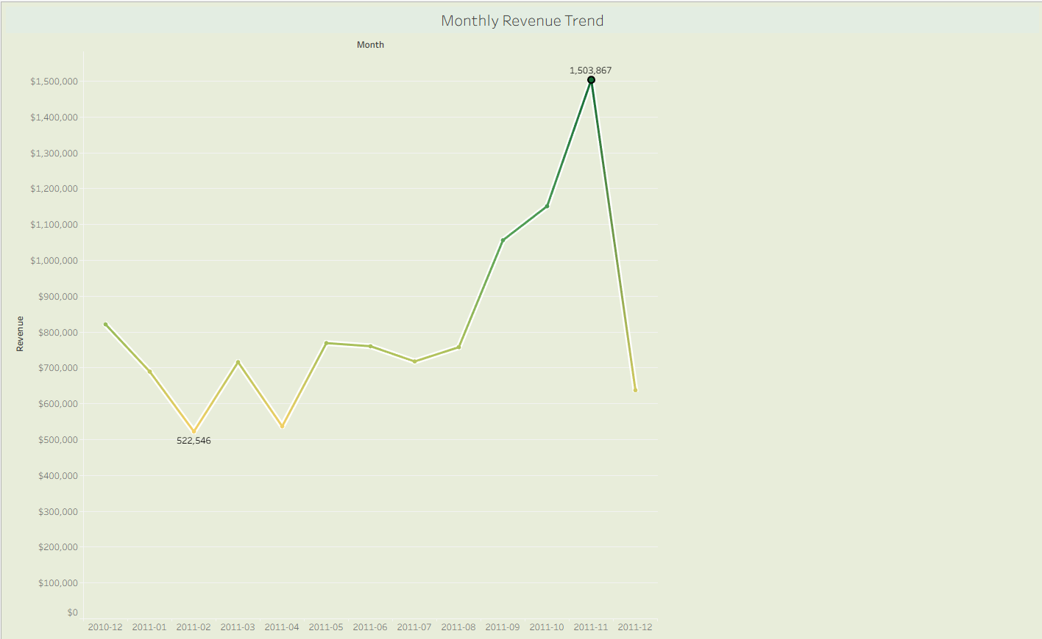
Revenue Trends
Key Findings
Strong Q4 growth – (AUG $757K – NOV 1.5M)
November 2011 highest month - $1.5M
Holiday season significantly impacts revenue
Recommendations
Increase inventory and marketing before Q4 demand peaks.
Expand marketing campaigns SEP – NOV
Ensure adequate staffing before holiday demand peaks

Slide 7
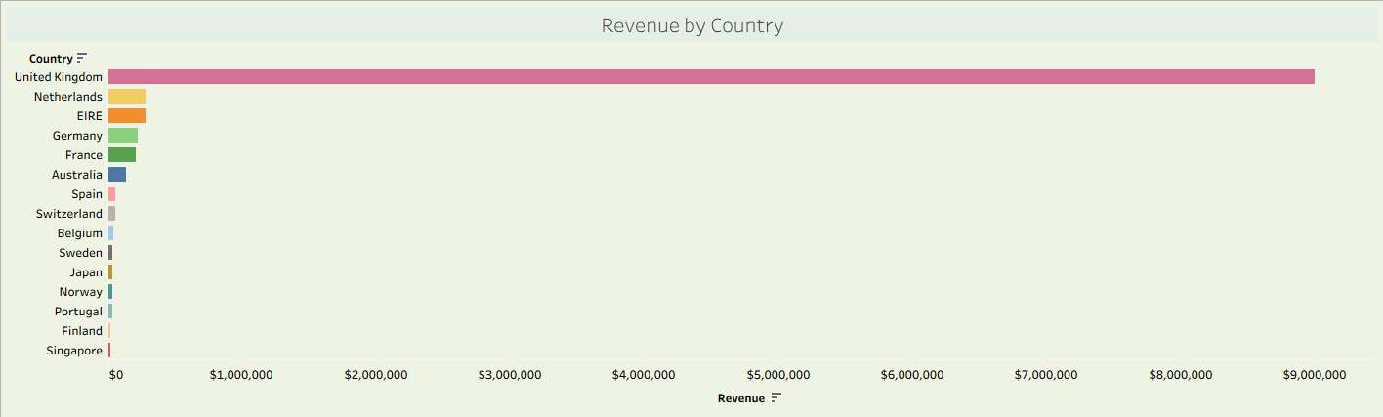
Geographic Analysis
Finding
84.6% of revenue originated from the United Kingdom.
Top Markets
United Kingdom
Netherlands
EIRE
Germany
France
Business Risk
Revenue dependence on a single market increases exposure to regional economic downturns.
Recommendation
Expand growth initiatives in European markets.

Slide 8
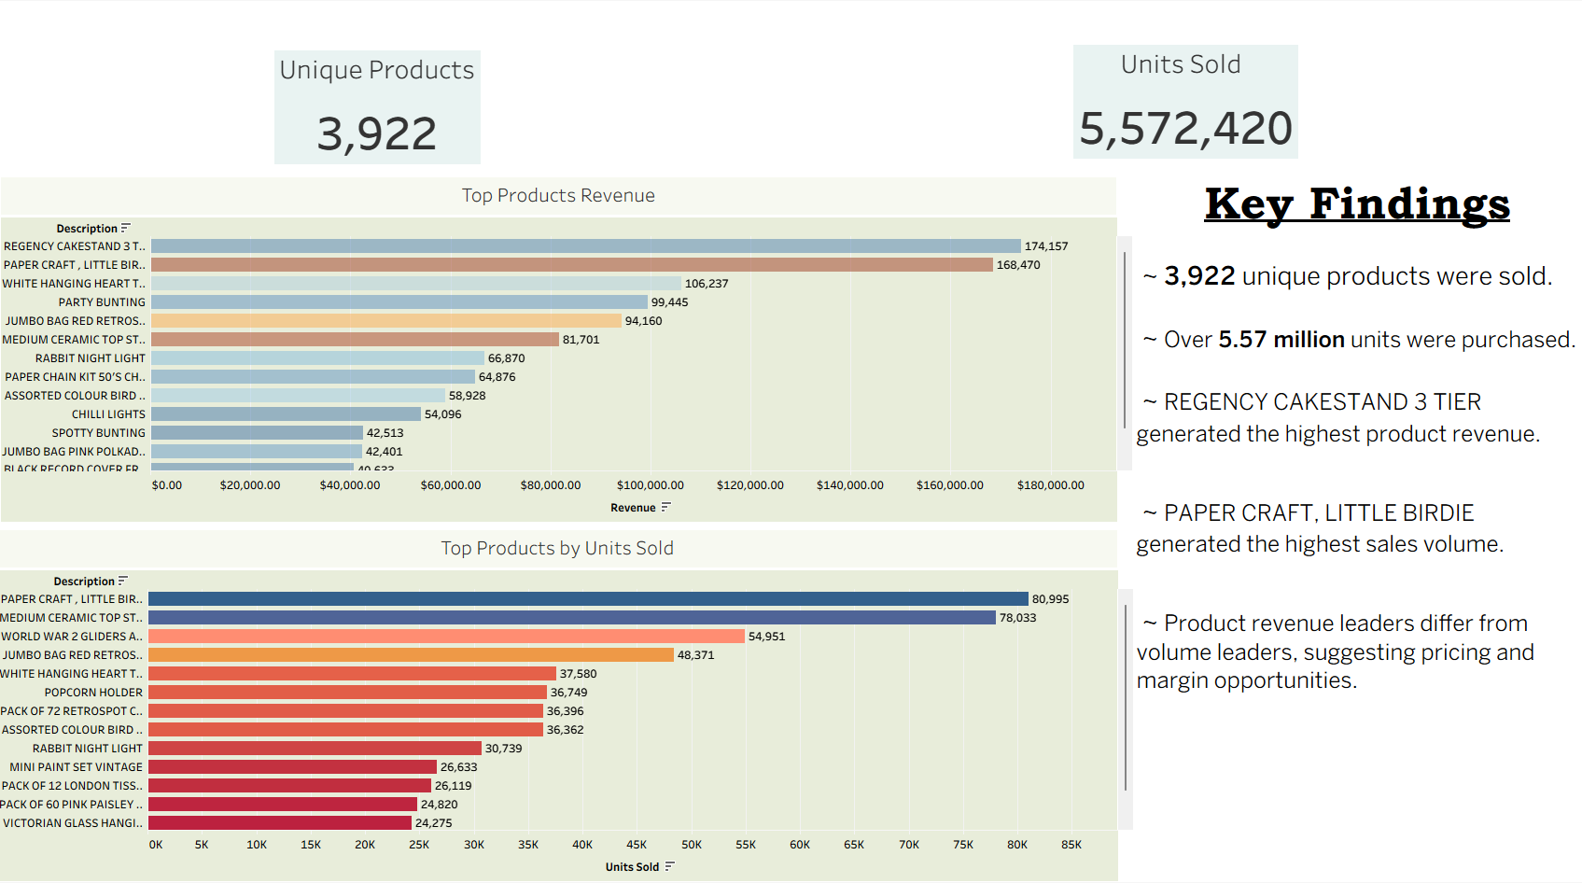

Slide 9
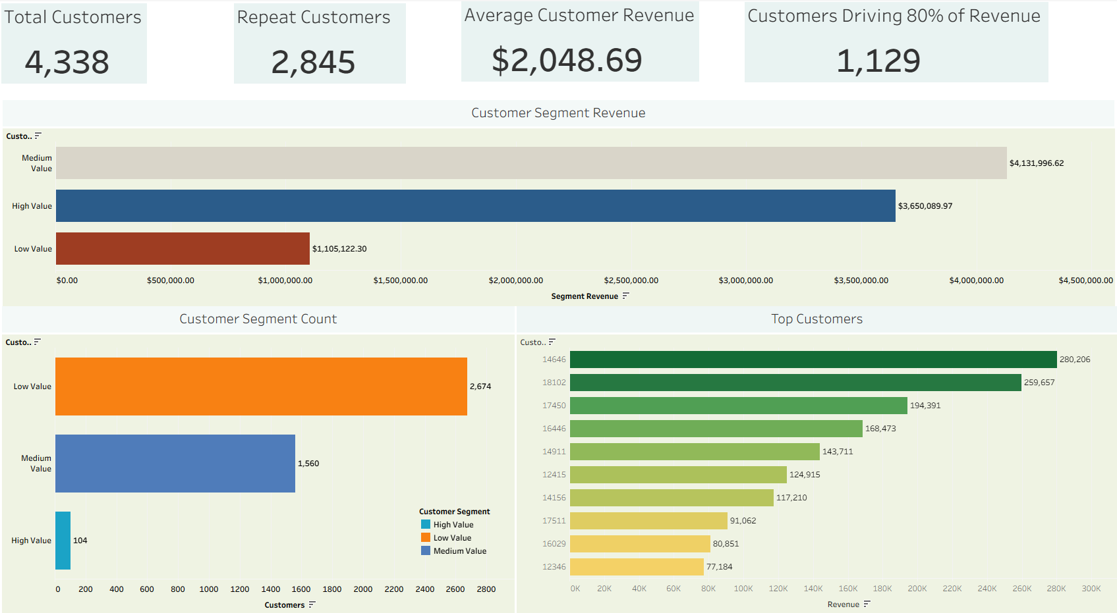

Slide 10
Pareto Analysis
Key Finding
1,129 customers (26%) generated approximately 80% of total revenue.
Interpretation
Revenue is concentrated among a relatively small customer segment.
Recommendation
Develop:
Loyalty programs
VIP customer outreach
Retention initiatives

Slide 11
Strategic Recommendations
Recommendation 1 | Recommendation 2 | Recommendation 3 | Recommendation 4
~ Prepare inventory and staffing for Q4 demand spikes. | ~ Focus customer retention efforts on high – value customers. | ~ Expand marketing in Germany, France, Ireland and the Netherlands. | ~ Promote top performing product categories.

Slide 12
Executive Summary & Final Recommendations
Key Findings
• Analyzed 541,909 retail transactions • Generated insights from $10.64M in revenue • Identified strong Q4 seasonal growth • Found that 26% of customers generated 80% of revenue • Discovered high customer retention with a 65.6% repeat purchase rate
Business Impact
• Revenue concentration risks were identified • High-value customer segments were defined • Product performance drivers were uncovered • Geographic growth opportunities were highlighted • Data-driven decision making was enabled through interactive dashboards
Recommendations
• Increase inventory before Q4 demand peaks • Strengthen loyalty programs for high-value customers • Expand marketing efforts in Germany, France, and the Netherlands • Promote top-performing product categories • Monitor customer retention and revenue concentration metrics
This analysis transformed raw transaction data into actionable business insights that support revenue growth, customer retention, and strategic decision-making.
Prepared by: Donald Benoit
Google Data Analytics Certificate ~BigQuery • SQL • Tableau

